Slide 1


Slide 2
White tea aqueous extract and Ascorbic acid counteract oxidative damage in Human Sperm
Ndivhuho B. Takalani¹, Thomas K. Monsees¹，Ralf Henkel^{1, 2}, Chinyerum S. Opuwari^{1,*}
¹Department of Medical Biosciences, University of the Western Cape, Robert Sobukwe Road, Bellville 7535, South Africa.
²LogixX Pharma, Theale, Reading, Berkshire RG7 4AB, United Kingdom

Slide 3
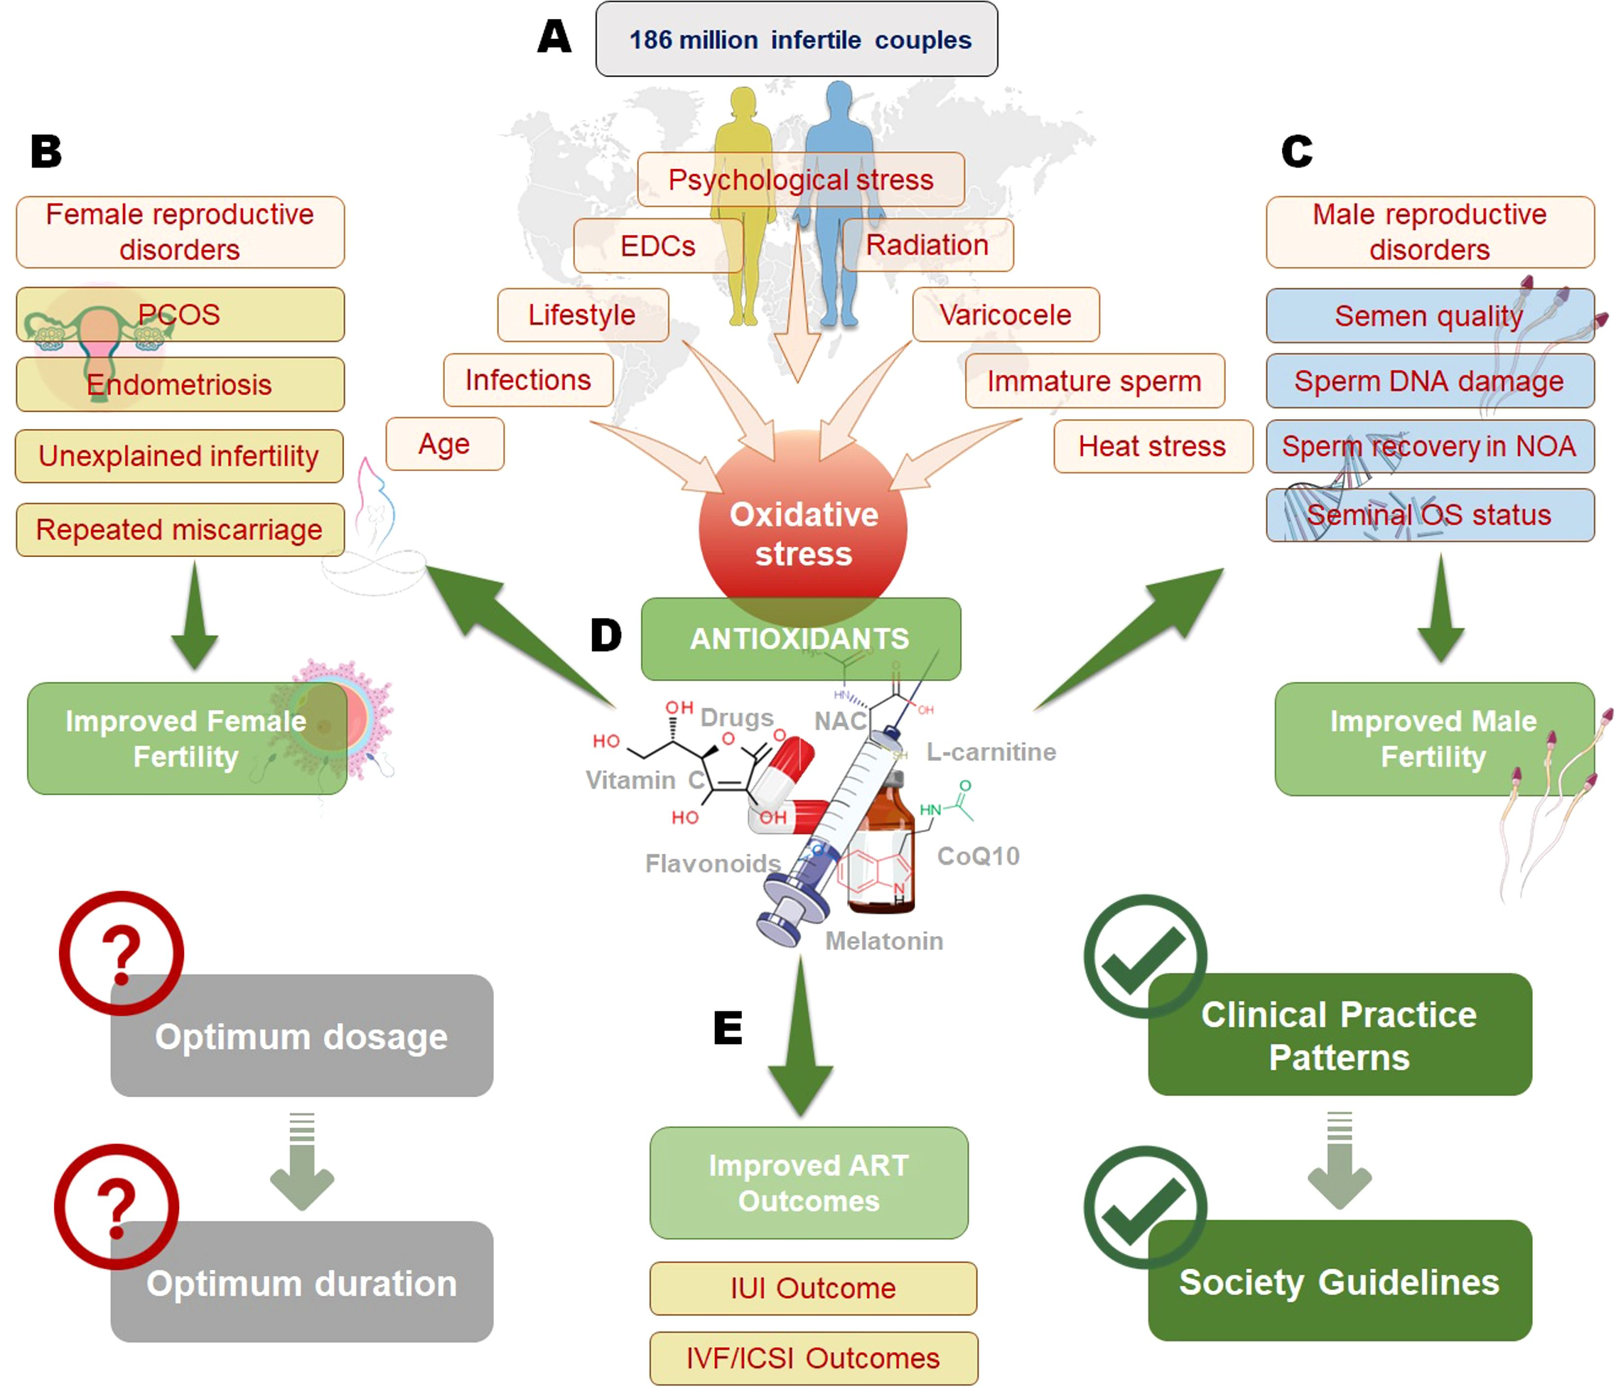
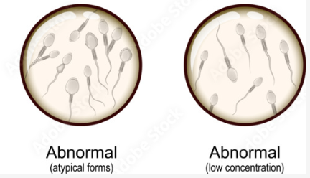
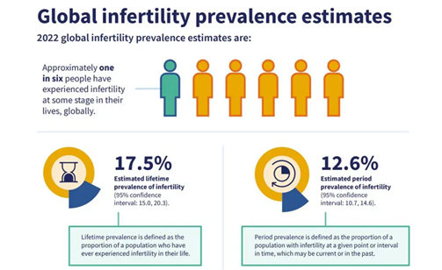
Male infertility & OXIDATIVE STRESS
PRIMARY & SECONDARY

Slide 4
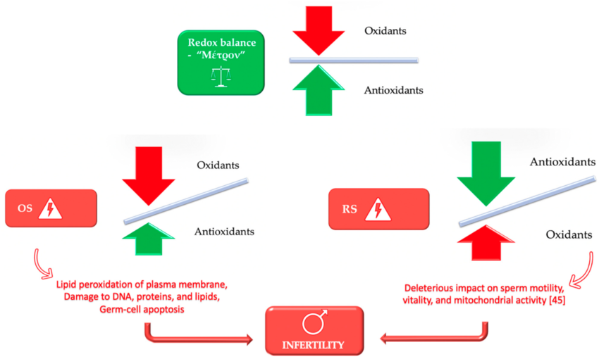

Redox imbalance
Oxidants (OS) / Reductive stress (RS)
High level of Reactive oxygen species (ROS)
Lipid peroxidation
DNA damage
Protein oxidation
Poor seminal parameters
Physiological level of ROS
Capacitation
Acrosome reaction
Hyperactivation
Sperm oocyte fusion
.

Slide 5
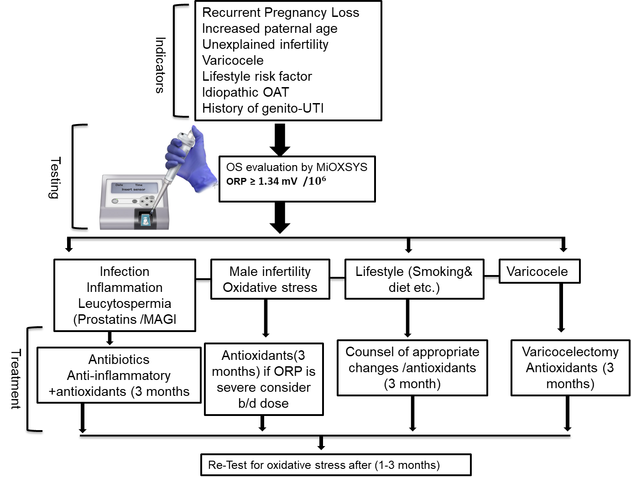
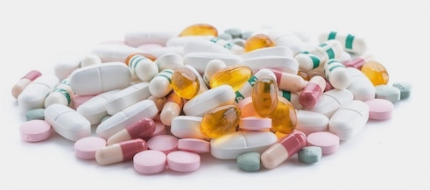
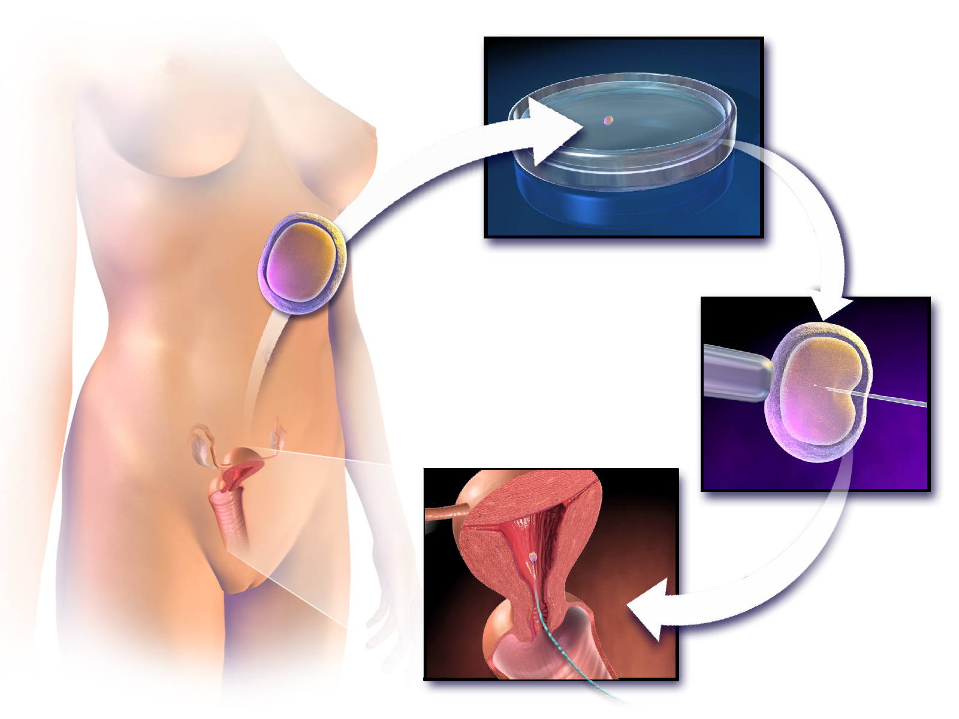
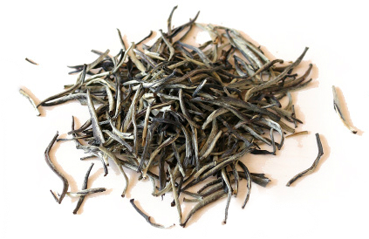
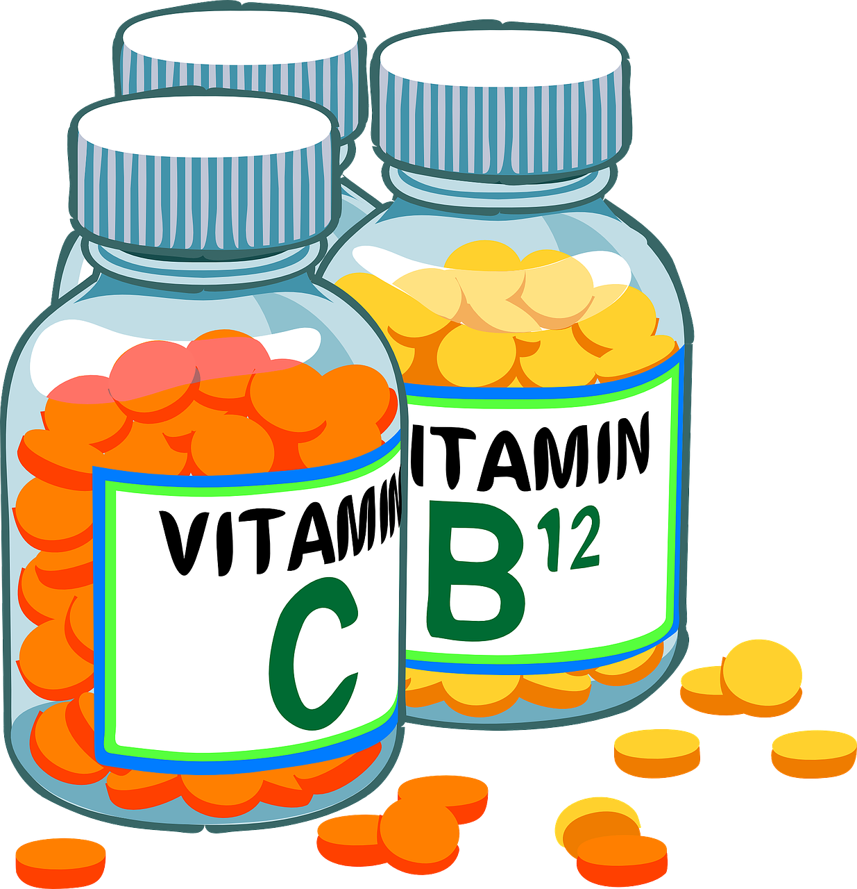
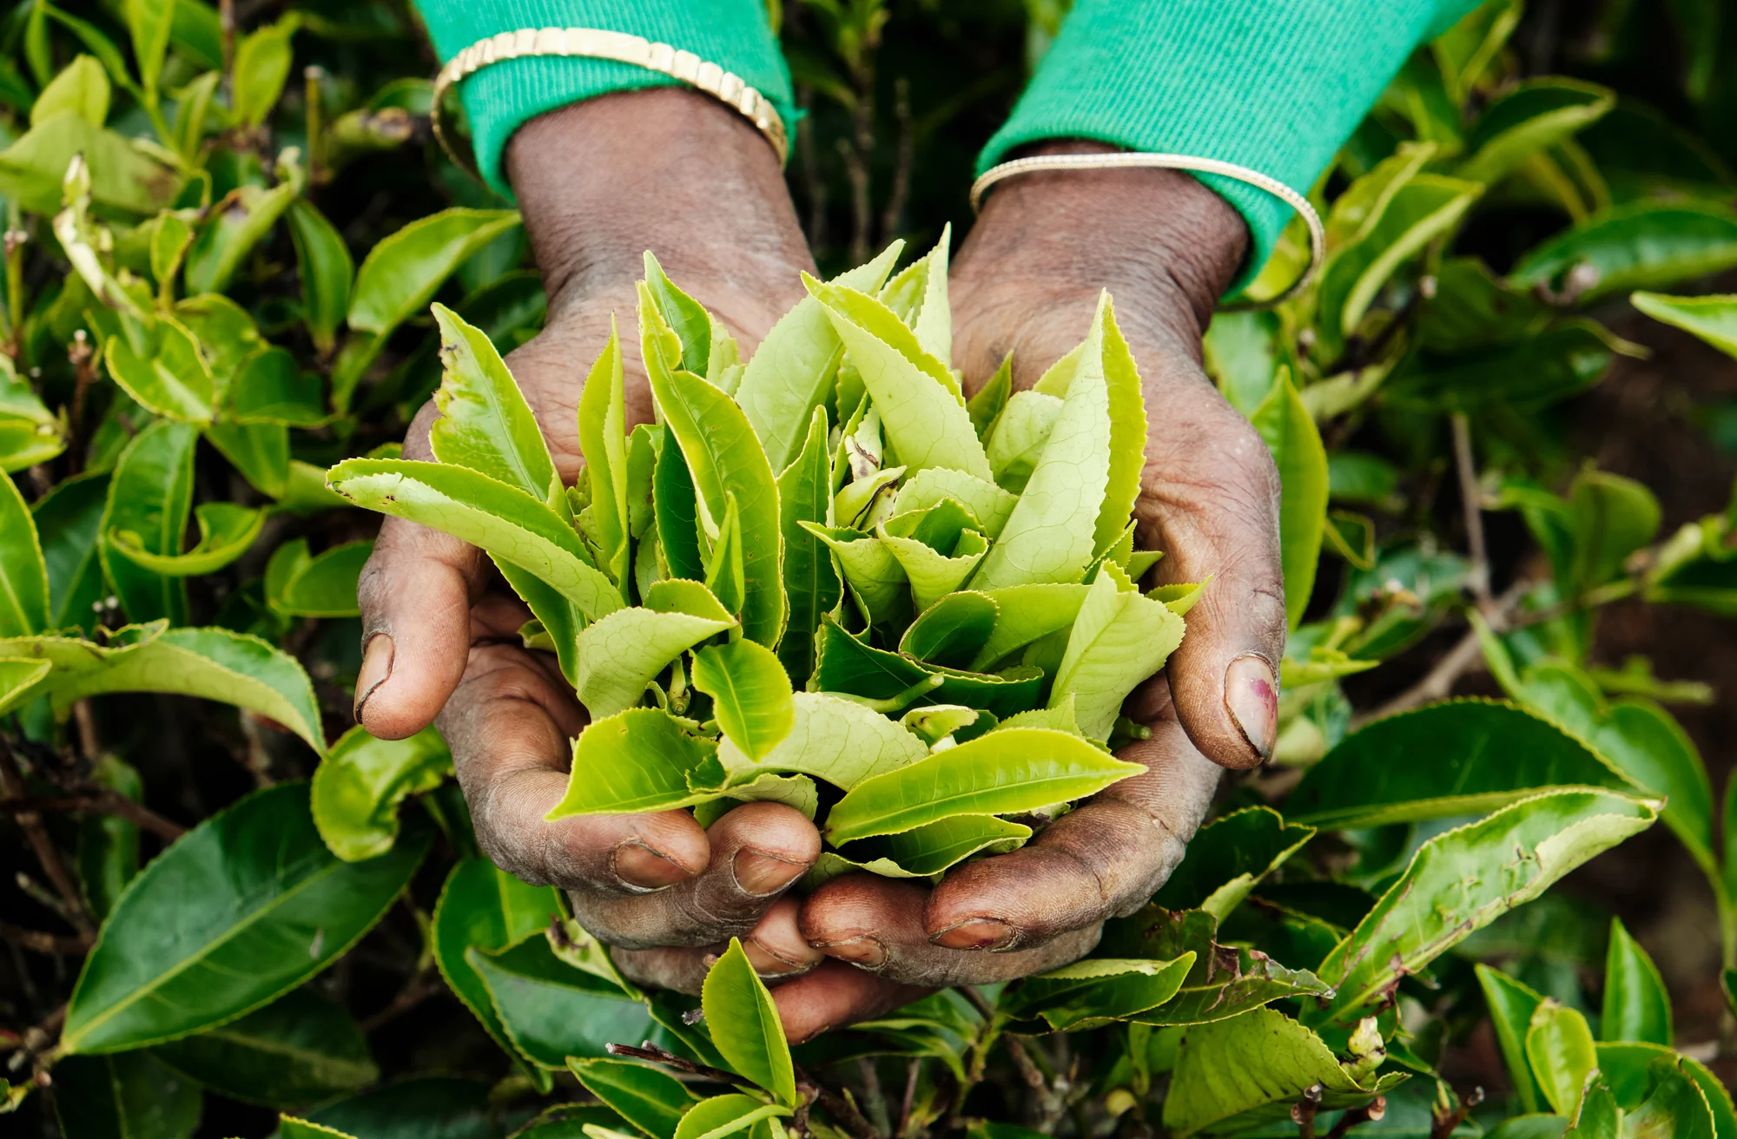

TREATMENT & INTERVENTIONS
FDA approved fertility drugs
In vitro fertilisation
Vitamins & Herbal medicinal plants
FDA: Food and drug administration
OAT : Oligoasthenoteratozoospermia
UTI: Urinary tract infection
MAGI: Male accessory gland infection

Slide 6
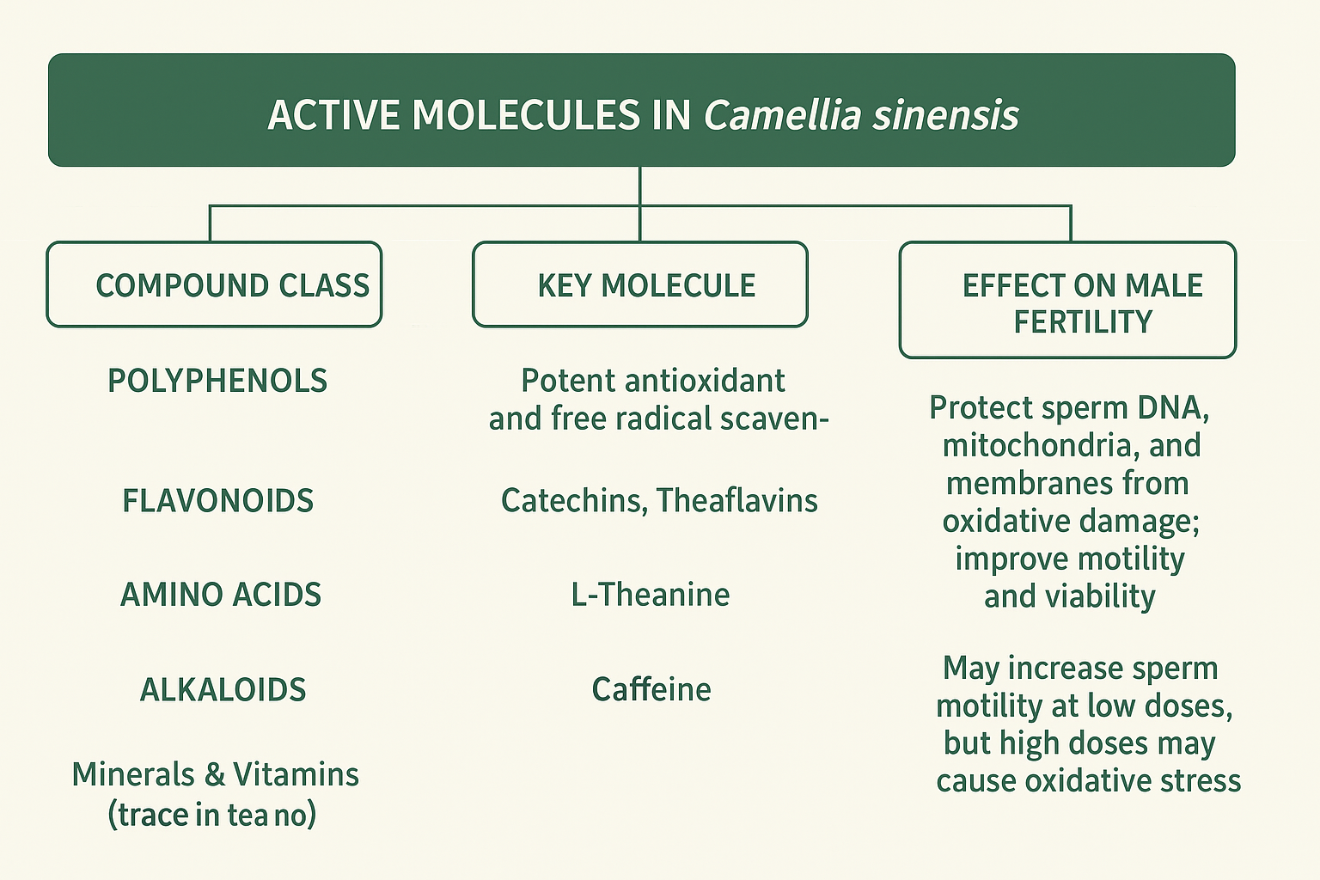
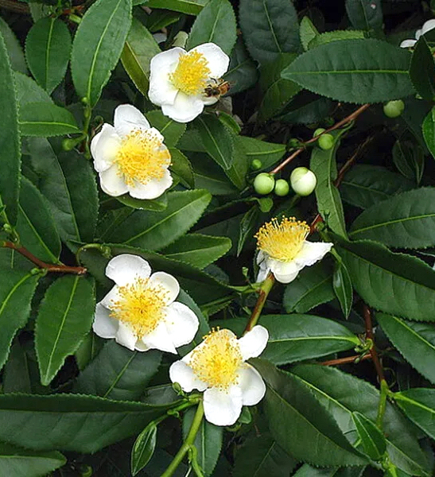

Study plant
Camellia sinensis

Slide 7
PROBLEM STATEMENT
Current semen analysis fall short in fully diagnosing male fertility, as they overlook measurement of oxidative stress — a critical factor in sperm health.
Although antioxidants show potential in combating oxidative damage, this vital marker remains underutilized in fertility assessments.
Without incorporating oxidative-stress measurements, many men may remain inadequately diagnosed and not treated holistically.
To improve outcomes, it is crucial to integrate oxidative-stress markers into routine semen analysis for a more comprehensive evaluation and more targeted treatment.

Slide 8
AIMS & OBJECTIVES
The study aims to evaluate the antioxidant activity of white tea aqueous extract on normozoospermic cells under oxidative stress induced by cumene hydroperoxide.
To measure the protective effect of white tea aqueous leaf extracts on the human sperm parameters: motility, ORP vitality for 60 and 120 minutes, and mitochondrial membrane potential, DNA-fragmentation, hyperactivation, capacitation and acrosome reaction for 60 minutes after inducing oxidative stress using cumene hydroperoxide
To determine the oxidation-reduction potential of the normozoospermic samples after treatment with white tea and ascorbic acid using the MiOXSYS.
To compare the antioxidant effect of white tea against ascorbic acid on normozoospermic samples following the induction of oxidative stress using cumene hydroperoxide for 60 and 120 minutes on seminal parameters

Slide 9
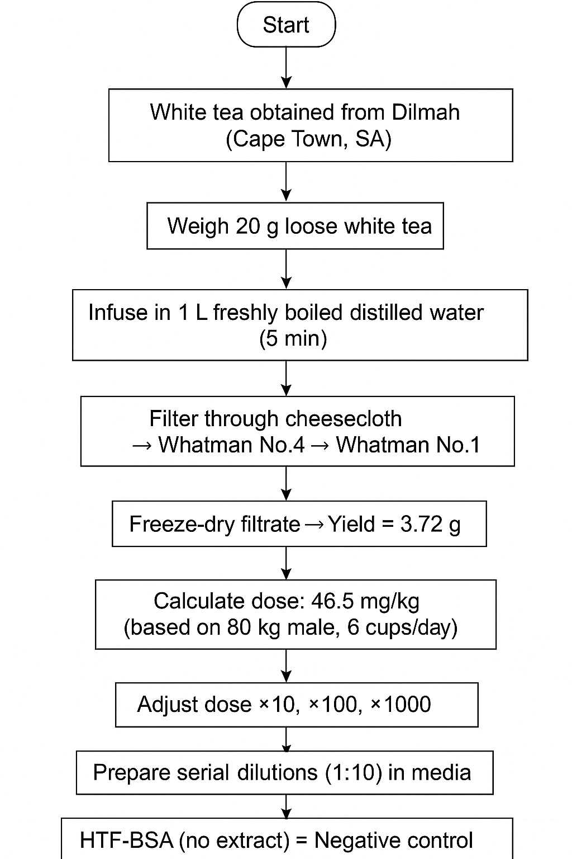
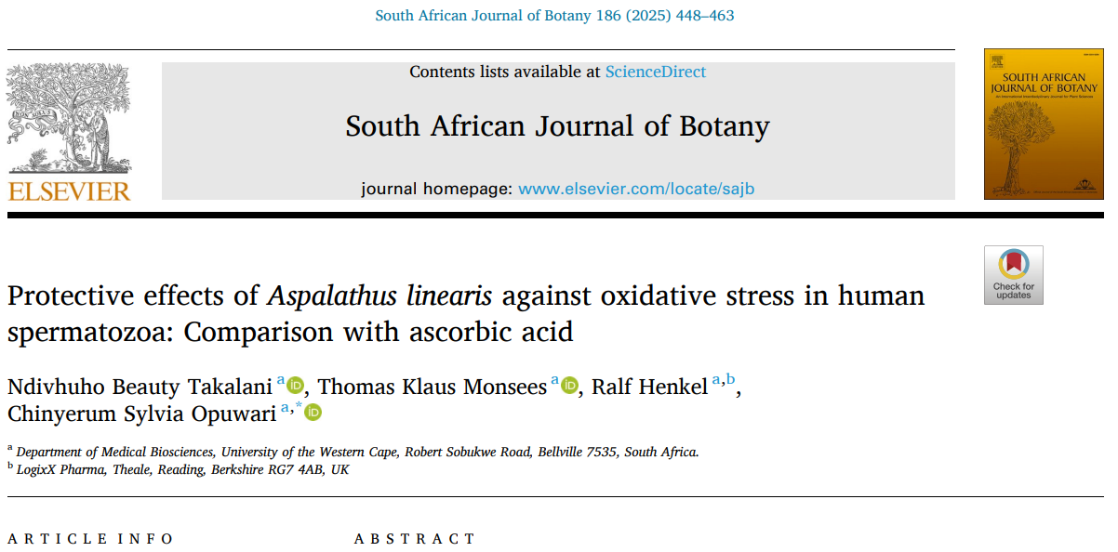
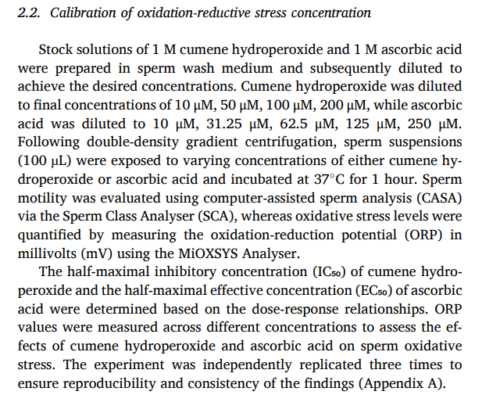

Plant , Ascorbic & cumene hydroperoxide acid preparation

Slide 10
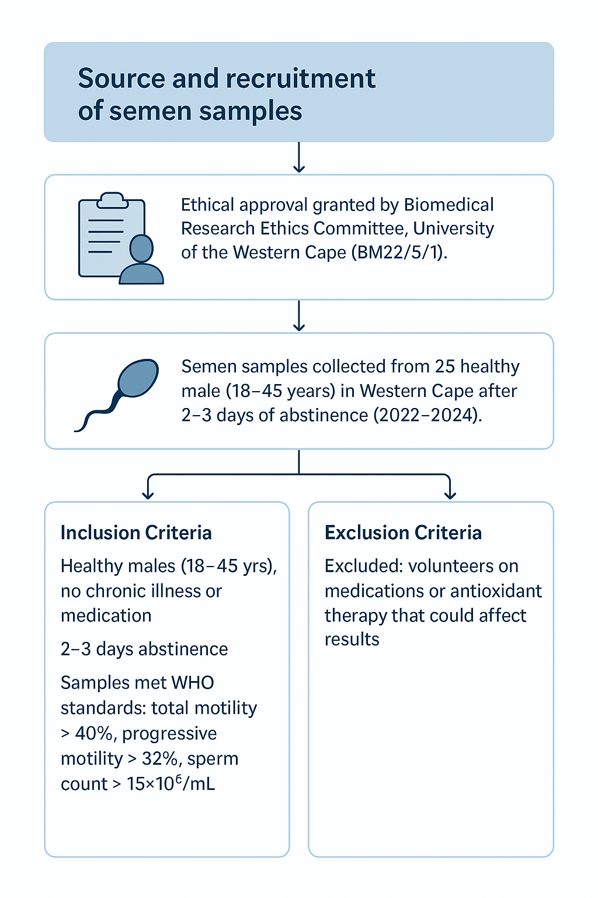
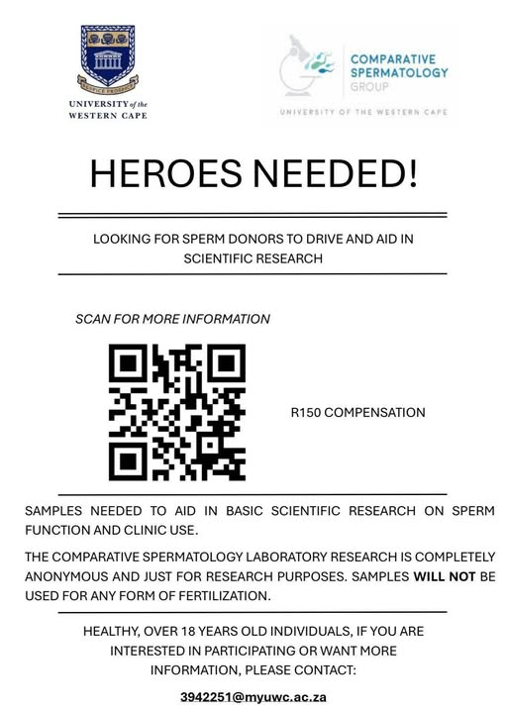
Sample collection & ethics

Slide 11
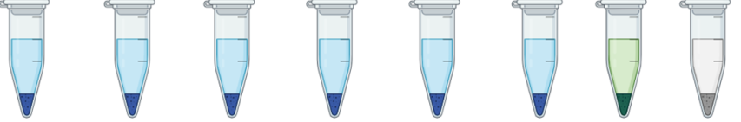
Experimental procedure
PC NC 10 31.25 0.465 4.65 46.5 465
CHP
ASC
WT
+ - + + + + + +
- - + + - - - -
- - - - + + + +
Sample collection n=25
Liquefaction
Motility test
BSA
CASA
AllGrad 40/80
Highly motile
120 minutes incubation 37°C
HTF-media
60 minutes incubation 37°C
Kinematics
Motility
VIT
ORP
AR
MMP
ROS
DNA
CASA
CASA
E&N
MiOXSYS
Hoesch
TMRE
DHE
TUNNEL
Nikon Eclipse 50i Microscope
Nikon Eclipse 50i Fluorescent Microscope
Cumene hydroperoxide
Ascorbic acid
White tea

Slide 12
RESULTS : KINEMATIC parameters
Parameter | White Tea vs. Positive Ctrl | White Tea vs. Negative Ctrl | Ascorbic Acid vs Positive Ctrl | Ascorbic Acid vs. Negative Ctrl
VCL | ↑ | Var / ↓ | ↑ | ↓
VAP | ↑ | ↓ | ↑ (at 10 µM) | ↓
VSL | ↑ | ↓ | ↑ (at 10 µM) | ↓
STR | ↑ | ↑ / ↔ | ↑ (60 min) | ↔ / ↓
LIN | Var (↑ 60 / ↓ 120) | ↓ | ↑ | ↓
WOB | ↑ | ↓ | ↑ | ↓
ALH | ↓ | ↓ | ↓ | ↓
BCF | ↑ | ↔ | ↑ (10 µM) | ↓
Hyperactivation | ↔ | ↓ | ↔ | ↓

Slide 13
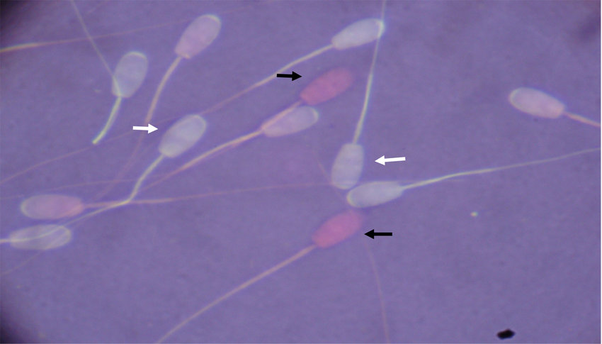
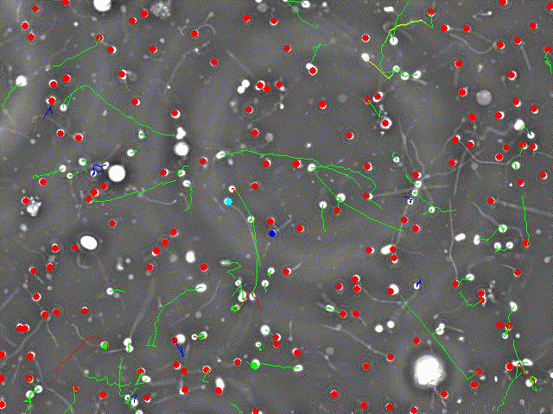
Sperm motility & vitality
Data for normozoospermic semen samples (n = 25) is presented as mean ± SD. Statistical significance was represented using one-way ANOVA, where (*) p < 0.05, (**) p < 0.01, (***) p < 0.001, and (****) p < 0.0001 indicate significance compared to the positive control, while (#) p < 0.05, (##) p < 0.01, (###) p < 0.001, and (####) p < 0.0001 indicate significance compared to the negative control. Two-way ANOVA-multiple comparison significance for 60 and 120 minutes is denoted by (^) p < 0.05, (^^) p < 0.01, (^^^) p < 0.001, and (^^^^) p < 0.0001. Comparisons between ascorbic acid concentrations and white tea aqueous extract are denoted by (d) p < 0.05, (c) p < 0.01, (b) p < 0.001, and (a) p < 0.0001 for 10 µM, while for 31.25 µM, significance is indicated by (e) p < 0.05, (f) p < 0.01, (g) p < 0.001, and (h) p < 0.0001.

Slide 14
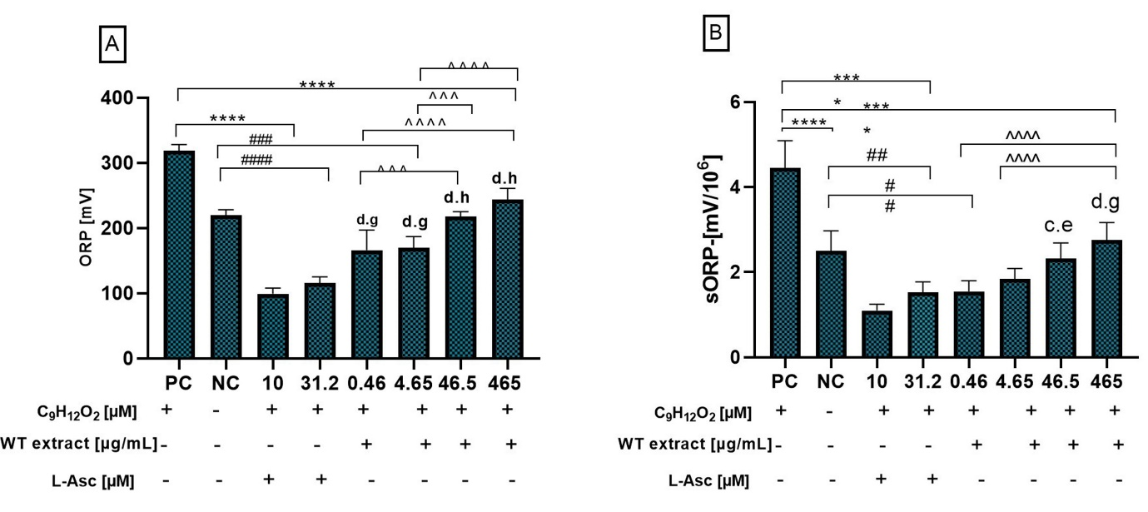
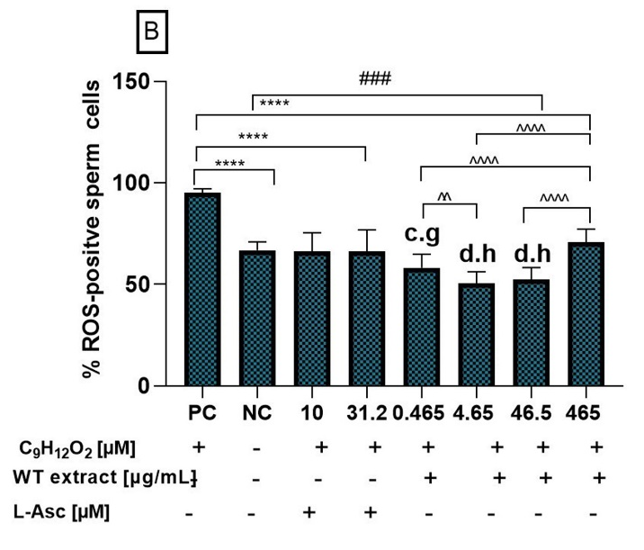
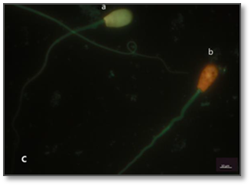
ORP & Reactive oxygen species
C
Data for normozoospermic semen samples (n = 25) is presented as mean ± SD. Statistical significance was measured using one-way ANOVA, where (*) p < 0.05, (**) p < 0.01, (***) p < 0.001, and (****) p < 0.0001 indicate significance compared to the positive control, while (#) p < 0.05, (##) p < 0.01, (###) p < 0.001, and (####) p < 0.0001 indicate significance compared to the negative control at 60 minutes. Multiple comparison significance is denoted by (^) p < 0.05, (^^) p < 0.01, (^^^) p < 0.001, and (^^^^) p < 0.0001. Comparisons between ascorbic acid concentrations and white tea aqueous extract are denoted by (d) p < 0.05, (c) p < 0.01, (b) p < 0.001, and (a) p < 0.0001 for 10 µM, while for 31.25 µM, significance is indicated by (e) p < 0.05, (f) p < 0.01, (g) p < 0.001, and (h) p < 0.0001

Slide 15
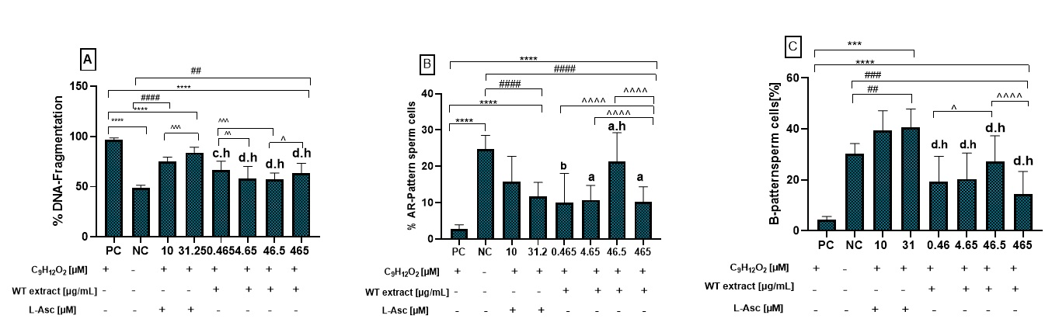

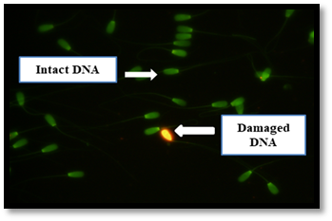
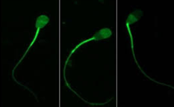
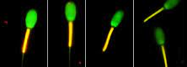
DNA fragmentation, CAPACITATION AND ACROSOME REACTION & MMP
D

Slide 16
RESULTS SUMMARY
Treatment / Condition | Effects on Sperm Parameters | Statistical Significance
Cumene hydroperoxide (OS induction) | ↓ Integrity of seminal parameters | p < 0.05
White tea aqueous extract | ↓ DNA fragmentation↓ ORP↓ ROS production↑ MMP integrity↑ Vitality↑ Motility | p < 0.05
Ascorbic acid (low concentration) | ↑ Acrosome reaction↓ ORP | p < 0.05
Ascorbic acid (high concentration) | ↑ Motility↑ Viability↓ Acrosome reaction↓ MMP↑ SDFNo change in ROS | p < 0.05 (except ROS: p > 0.05)

Slide 17
CONCLUSION
Section | Description
Findings | • White tea extract shows potential as a natural antioxidant. • May improve sperm function and reduce oxidative stress, thereby enhancing male fertility.
Limitations | • In vitro design may not fully represent in vivo conditions. • Long-term effects on sperm function not evaluated. • Bioactive compounds responsible for observed improvements not identified • Extracellular ROS not measured.
Future Research Recommendations | • Isolate and characterize specific bioactive compounds in white tea. • Evaluate long-term effects on sperm function. • Determine clinical efficacy and safety through in vivo and clinical studies. • Bridge laboratory results to clinical application.

Slide 18
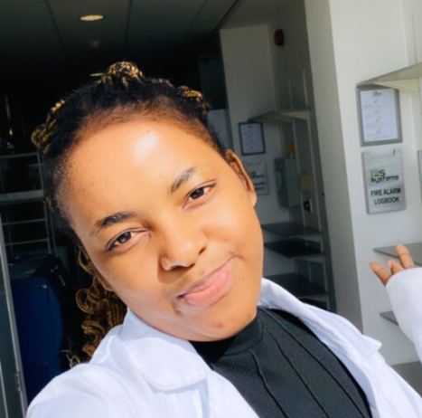

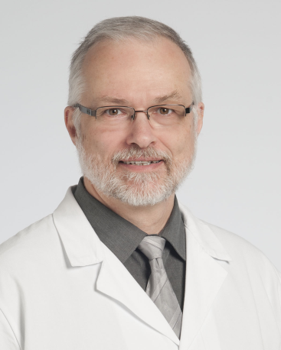





APPRECIATION

